Slide 1
SALES ANALYSIS

Slide 2
Questions and hypothesis
Approach and analysis
Monthly Sales
Regions and Sales
Category Preference
Top 10 Cities
Results
CONTENTS

Slide 3
Questions to Answer
1.Does the discount amount affect the sales? Is there any correlation between the discount offered and the quantity of items ordered?
2. what was the best month for sales? how much was earned that month?
3. Give me the top10 cities sales data which contributed the most sales wise?
4. Which categories of items are most commonly sold? Are there any categories that significantly contribute to the overall sales?
5. Can we identify any patterns or trends in customer demographics such as gender, age, or location that correlate with their purchasing behavior?
6. What is the distribution of the order status? How many orders are completed, canceled, or pending?
7. What is the distribution of the order status? How many orders are completed, canceled, or pending?

Slide 4
Approach and Analysis
1.Dataset is imported from Kaggle
2. Formatted and cleaned
3. The columns Price, quantity ordered, month, Region, Discount Percent, Sales will
be considered to answer our questions
4. Statistical inference and graphical visualization will be employed

Slide 5
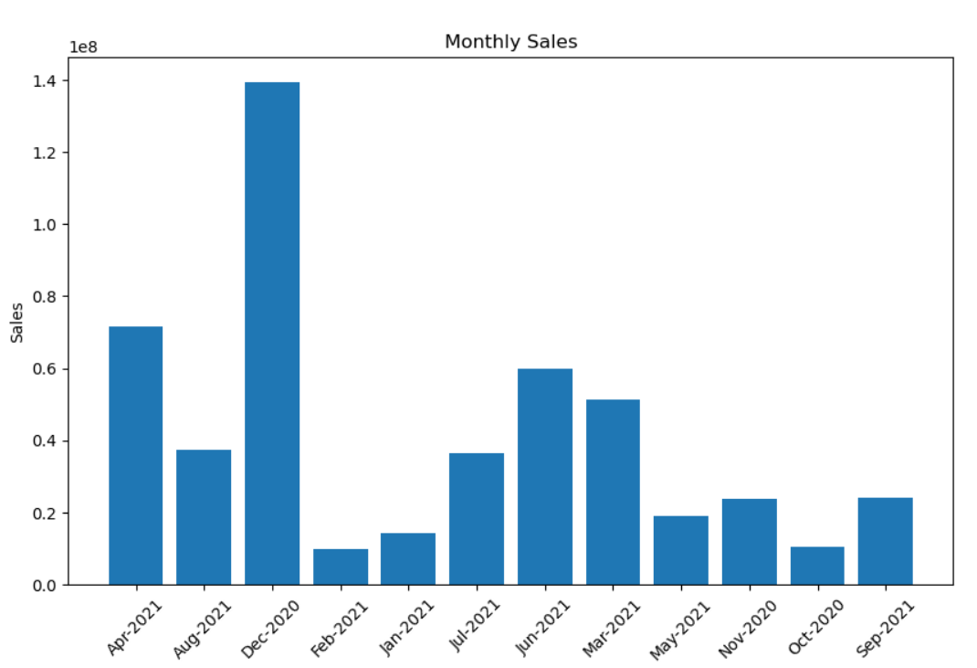
Monthly Sales
December has the highest sales, one of the reasons of sales might be holiday season

Slide 6
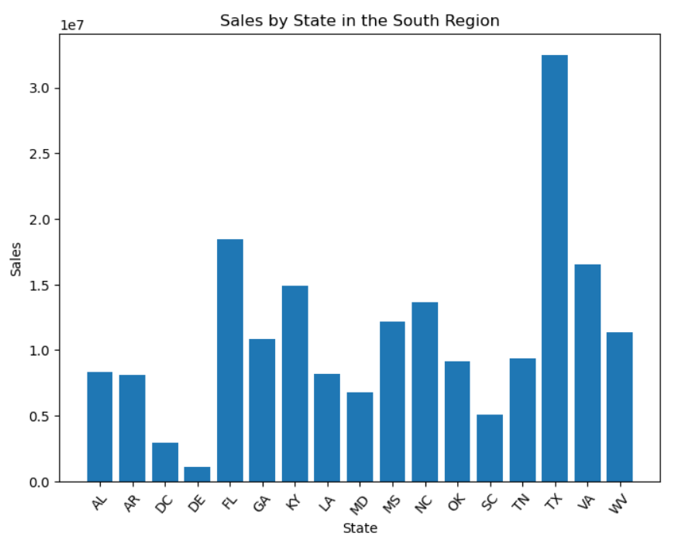
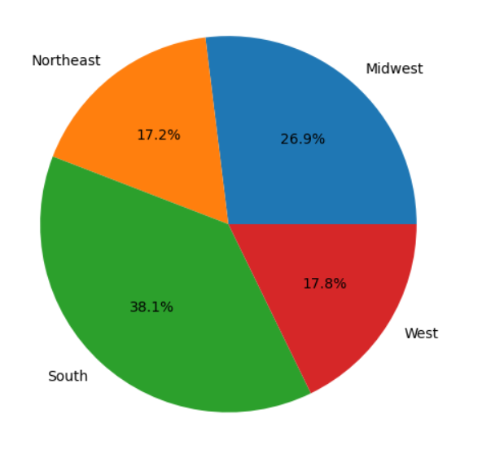
Regions and Sales
South Region has the highest sales and In south region Texas contributed the most followed by Florida.

Slide 7
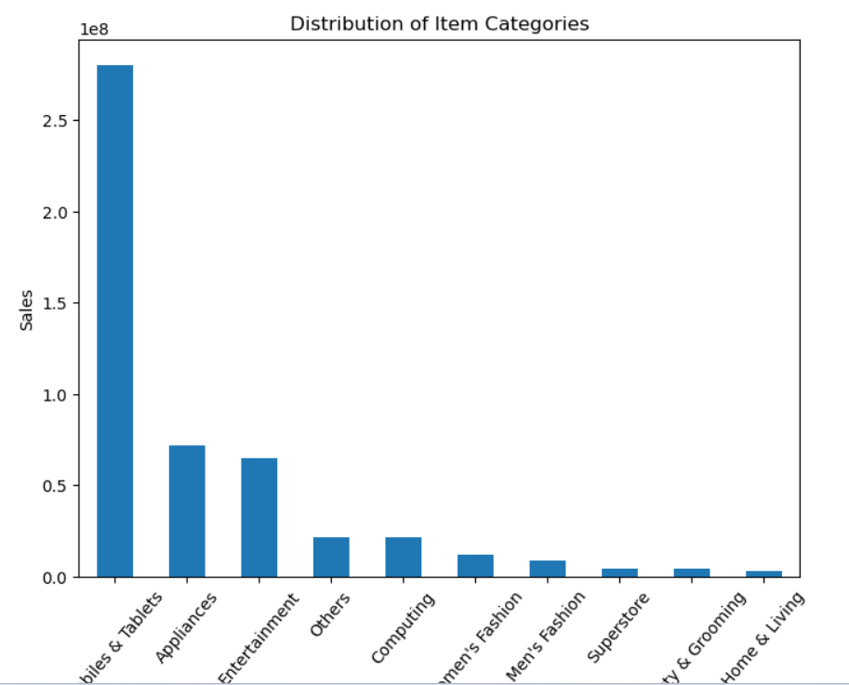
Category Preference
Mostly the Sales contributed by the mobiles and Tablets category whereas others category contributed far more less as comparison to mobiles & tablets. We can investigate it further and according to that plan campaign and other customer engagement activities to improve it in other categories.

Slide 8
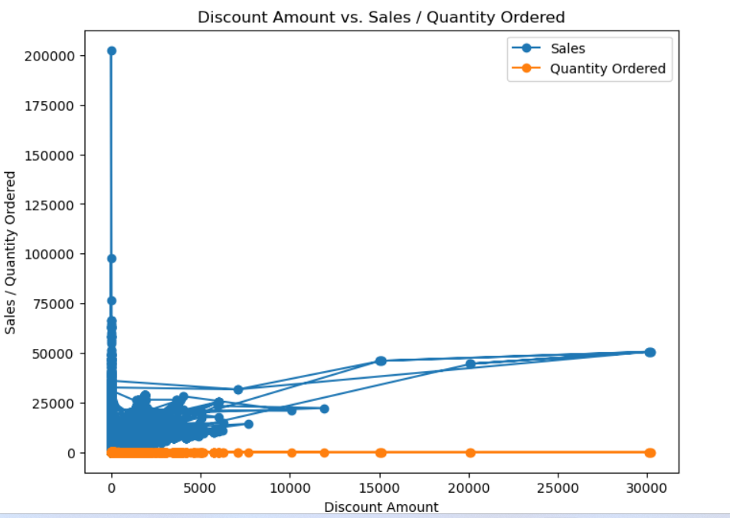
Discount Amount vs Sales/Quantity Ordered
Here we can clearly see that By increasing discount amount Sales goes higher whereas there is negligible amount in quantity ordered, it does not affect it

Slide 9
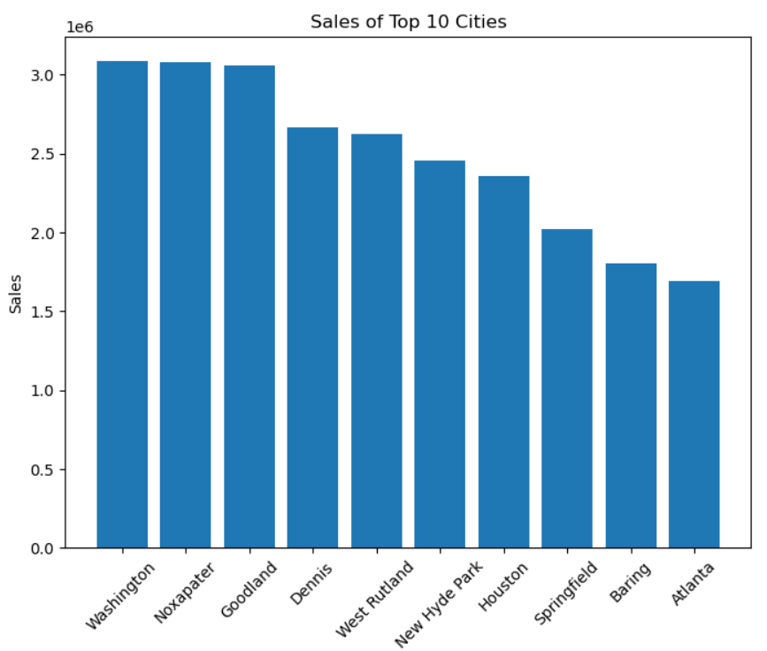
Top 10 Cities
These are the Top 10 cities which contributed the most in terms of Sales

Slide 10
Insights
There is negligible difference spot in quantity ordered while sales are increasing.
December has the highest sales in US, most probably because of holiday season in december.3,929,270,000
Majority of orders are cancelled as comparison to complete and received orders, this could be lead us to to find the underlying issue or areas of improvement like engaging customer interaction, overall user experience and customer dissatisfaction.
clearly mobile tablets has most sales followed by appliances
most of the payments are done by cash on delivery which is 35.9% followed by Pay axis
South region has more sales as comparison to others. Let's see top 5 or 10 state of south region which are contributing the highest sales
Texas has the highest sales in southern region
most likely the age group of 61+ appears to be more in terms of purchasing, this is slightly odd and less is 20 age group, where we can improve our focus to increase purchasing by marketing, advertisement etc. let's see in terms of sales which age group has the highest sales
Here we can see the highest sales are done by age group61+ followed by 31-40, but the main point here is that age group 51-60 has more purchasing as comparison to 21-30 age group still it has lowest sales than 21-30 age group, this leads to the one of possibility to revise and consider the price of products.
Washington, Noxapater and Goodland has the highest sales

Slide 11
Thank You

